Slide 1
CAPSTONE PROJECT
Analysis on Uber/Lyft Cab Prices and Weather Impact on Surcharge

Slide 2
PROBLEM OVERVIEW
Context:
In the dynamic ride-hailing market, surge pricing is a critical element that impacts
customer satisfaction and driver availability. Surge prices are influenced by factors
like demand, location, and weather conditions.
Goal:
The objective is to create a comprehensive data pipeline that analyzes Uber/Lyft cab
prices and explores how weather impacts surcharges. By implementing a robust system,
businesses can gain valuable insights into price fluctuations and external factors affecting
the ride-hailing ecosystem.

Slide 3
Details of Input Data
Sources of Data:
Uber Dataset: Stored in Azure Blob Storage, containing cab ride data for various Uber cab types and their prices for specific locations.
Lyft Dataset: Stored in an Azure SQL database, covering various Lyft cab types and prices for specific locations.
Weather Dataset: Available in HTTP format, containing weather attributes such as temperature, rain, and cloud coverage for all locations in the dataset.

Slide 4
Tech Stack:
Data Ingestion: Azure Data Factory
Landing Zone: Azure Cosmos DB
Data Processing & Transformation: PySpark in Azure Databricks
Materialized Views: Azure SQL Database
Visualization Layer: Databricks Dashboard

Slide 5
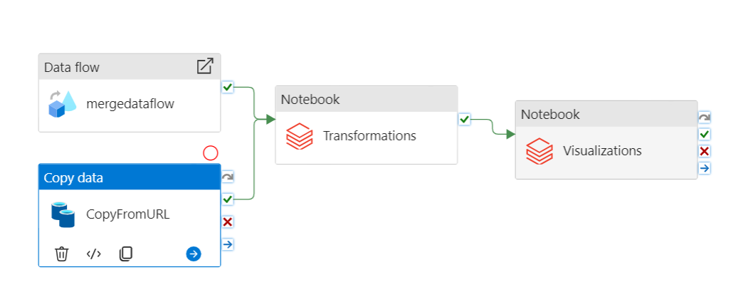
Solution Flow Diagram - ADF Pipeline

Slide 6
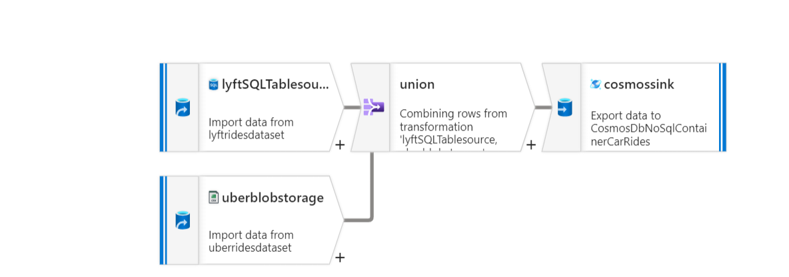
Solution Flow diagram

Slide 7
Steps Overview:
Azure Environment Setup: Successfully configured Azure Data Factory (ADF), Databricks, Cosmos DB, and SQL Database.
Data Ingestion: Established data pipelines using ADF to ingest data from Blob Storage (Uber data), Azure SQL Database (Lyft data), and HTTP (weather data).
Data Transformation: Performed data cleaning and enrichment in Databricks with PySpark.
Materialized Views: Created materialized views for optimized querying.
Data Visualization: Developed interactive dashboards in Databricks for insightful analysis.

Slide 8
Solution Benefits
Revenue Insights: Although Uber had a higher number of rides,
Lyft generated more revenue due to surge pricing.
Surge-Weather Analysis: There was no significant correlation
between weather conditions and surge pricing.
Enhanced Decision Making: The insights help stakeholders better
understand pricing trends and improve pricing strategies.
Operational Efficiency: Automated data pipelines using ADF and
Databricks streamlined data ingestion and transformation.

Slide 9
Testing
Test Data: Used the Kaggle dataset alongside live data collected from APIs for testing.
Testing Steps:
Verified the dashboards against SQL query results for accuracy.
Validated data ingestion pipelines using small batches of data.

Slide 10
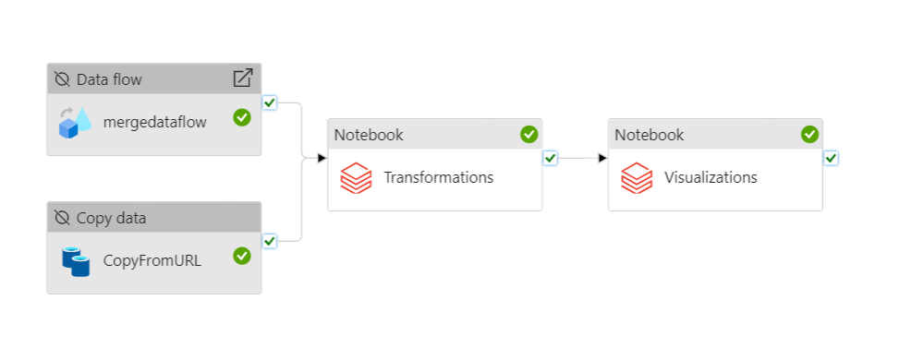
Results

Slide 11
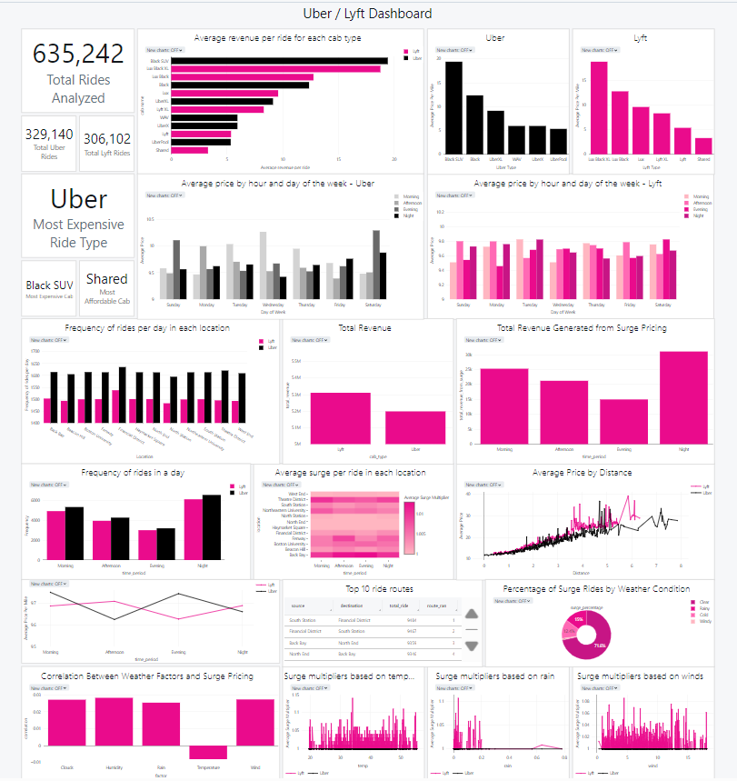
Results - Dashboard

Slide 12
Challenges faced
Pipeline Delays: Pipelines took a long time to run.
Data Consistency: Misaligned timestamps across sources needed careful handling.
Scaling Issues: Performance challenges with large datasets were mitigated through optimization in Databricks.

